Slide 1
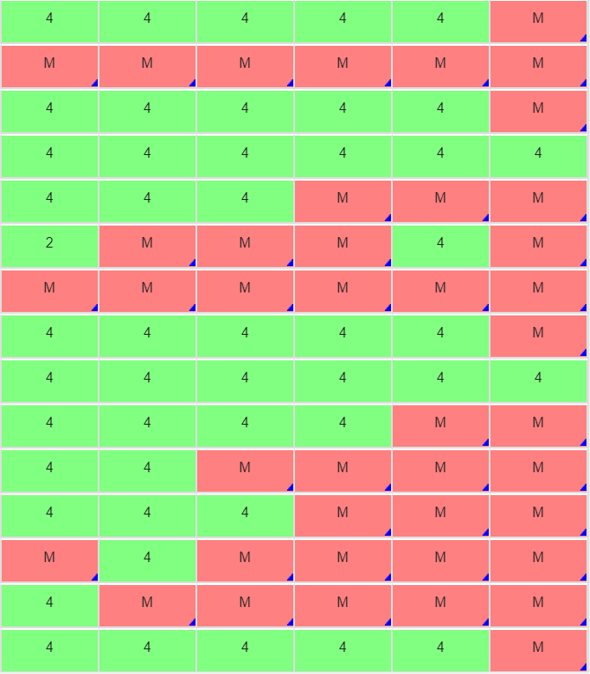

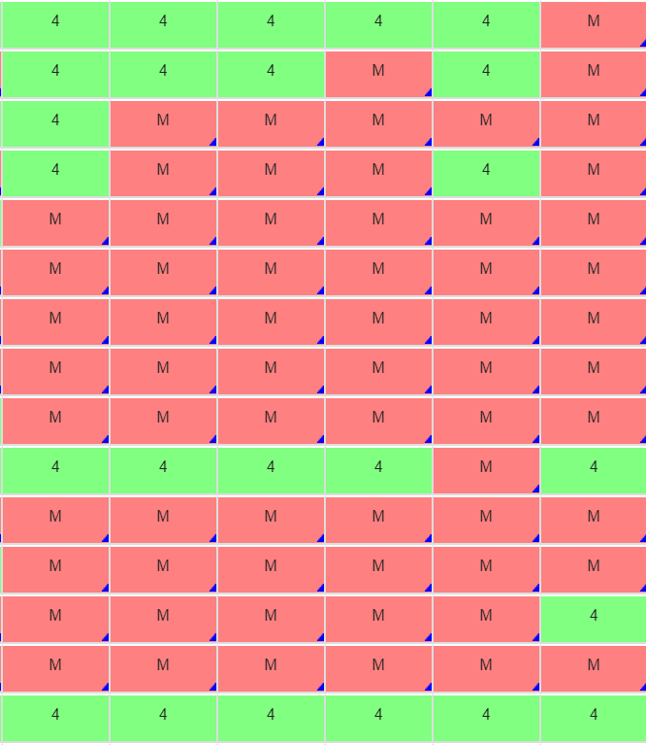
Go Over the Test

Slide 2
ALGEBRA 3
Day 23

Slide 3
Remember: Things on Test
Domain and Range – Is it a function?
Find the slope (given y=mx+b, ax+by=c, or two points)
Given points, write equation as y=mx+b if a line
Write equation of line (given slope and point or two points)
Graph and describe transformation of quadratic
Graph and describe transformation of absolute value
Write equation and solve a story problem

Slide 4
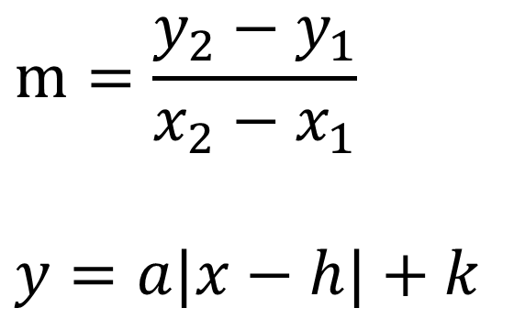

Equations Need for Test
$$m=\frac{y_{2}−y_{1}}{x_{2}−x_{1}}$$
$$y=a|x−h|+k$$
$$y=mx+b$$
$${y−y}_{1}=m\left(x−x_{1}\right)$$

